Slide 1

Dealing with Messy Data
Steve Elston
Copyright 2018, 2019, 2020, 2021, 2022, 2023 2024, Stephen F Elston. All rights reserved.

Slide 2
Linear Model Assumptions
There are a number of assumptions in linear models that you overlook at your peril!
The feature or predictor variables should be independent of one another
This is rarely true in practice
Multi-colinearity between features makes the model under-determined
We assume that numeric features or predictors have zero mean and about the same scale
We do not want to bias the estimation of regression coefficients with predictors that do not have a 0 mean
We do not want to have predictors with a large numeric range dominate training
Example: income is in the range of 10s or 100s of thousands and age is in the range of 10s, but apriori income is no more important than age as a predictor
Values of each predictor or feature should be iid
If variance changes with sample, the optimal value of the coefficient could not be constant
If there serial correlation in the predictor values, the iid assumption is violated - but can account for this such as in time series models

Slide 3
Introduction
Several commonly encountered data problems create problems for OLS and GLM models
Zero inflated response variables have an unusual number of zero values
Use a mixture model to switch between a binomial and another distribution
Over-dispersed response variables have a long (typically right) tail
Apply models with distributions and mixtures that account for large low probability responses
Outliers in independent variables have an undue influence on OLS and GLM models
Robust regression models limit the influence of outliers on the response
We can extend the OLS and GLM frameworks to deal with these situations

Slide 4
Models for Zero-Inflated Response

Slide 5
Zero-Inflated Responses
Zero-inflated response variables arise in many situations
Most people who view an ecommerce site buy 0 products
Most auto drivers have no crashes per year
In much of the world the average rainfall amount on a specific day is 0
The number of sever weather events in a specific area per month is often 0
In epidemiology the probability distribution of the number of people contracting a disease in per day has many zeros
Etc.

Slide 6
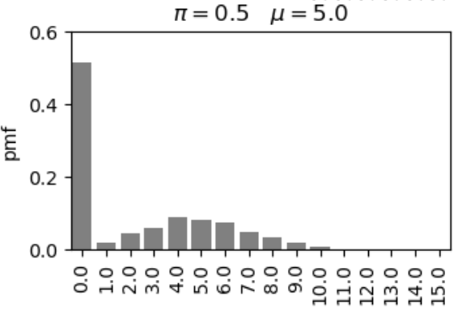
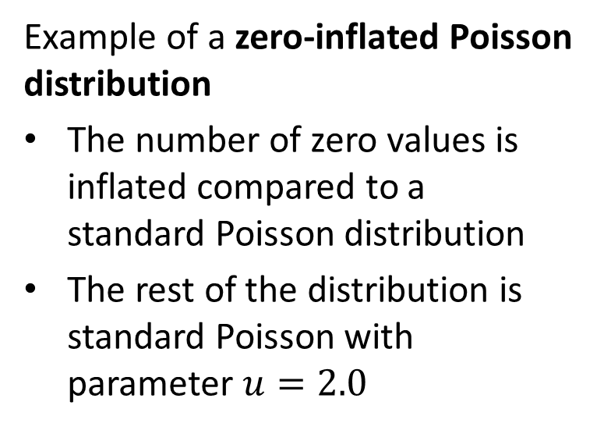
Zero-Inflated Responses
Example of a zero-inflated Poisson distribution
The number of zero values is inflated compared to a standard Poisson distribution
The rest of the distribution is standard Poisson with parameter $u=2.0$

Slide 7
Modeling Zero-Inflated Distributions
How can we model zero inflated distributions?
Standard ‘named’ distributions do not account for zero-inflation
Can use a mixture of two distributions
A binomial distribution
One or more standard distributions
The binomial distribution serves as a ‘switch’ between 0 response and the other distribution

Slide 8
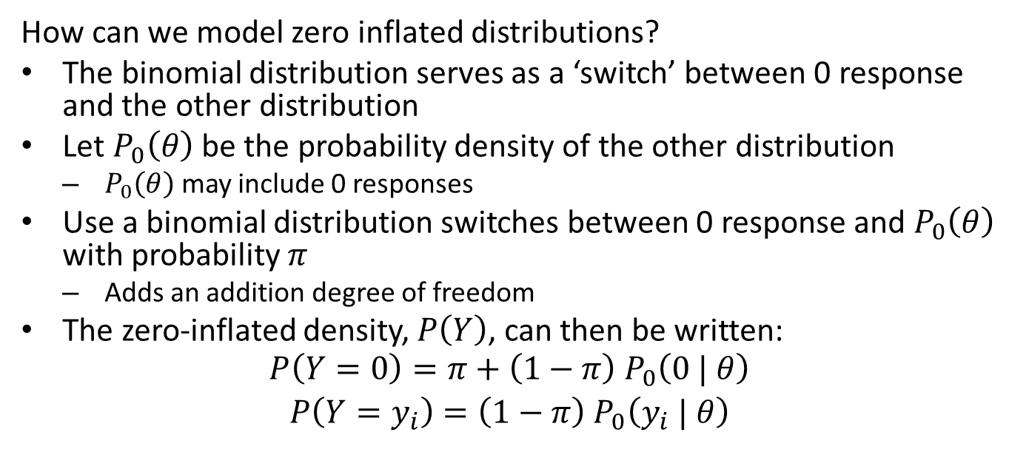
Modeling Zero-Inflated Distributions
How can we model zero inflated distributions?
The binomial distribution serves as a ‘switch’ between 0 response and the other distribution
Let $P_{0}\left(θ\right)$ be the probability density of the other distribution
$P_{0}\left(θ\right)$ may include 0 responses
Use a binomial distribution switches between 0 response and $P_{0}\left(θ\right)$ with probability $π$
Adds an addition degree of freedom
The zero-inflated density, $P\left(Y\right)$, can then be written:
$$\begin{matrix}P\left(Y=0\right)=π+\left(1−π\right){ P}_{0}\left(0 | θ\right) \\ P\left(Y=y_{i}\right)=\left(1−π\right){ P}_{0}\left(y_{i} | θ\right)\end{matrix}$$

Slide 9
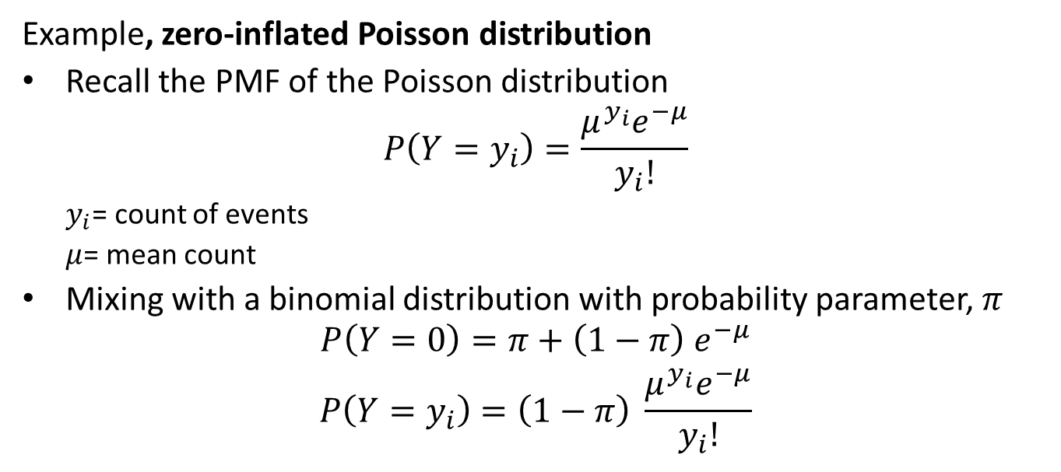
Zero-Inflated Poisson Distribution
Example, zero-inflated Poisson distribution
Recall the PMF of the Poisson distribution
$$P\left(Y=y_{i}\right)=\frac{μ^{y_{i}}e^{−μ}}{y_{i}!}$$
$y_{i}$= count of events
$μ$= mean count
Mixing with a binomial distribution with probability parameter, $π$
$$\begin{matrix}P\left(Y=0\right)=π+\left(1−π\right){ e}^{−μ} \\ P\left(Y=y_{i}\right)=\left(1−π\right) \frac{μ^{y_{i}}e^{−μ}}{y_{i}!}\end{matrix}$$

Slide 10
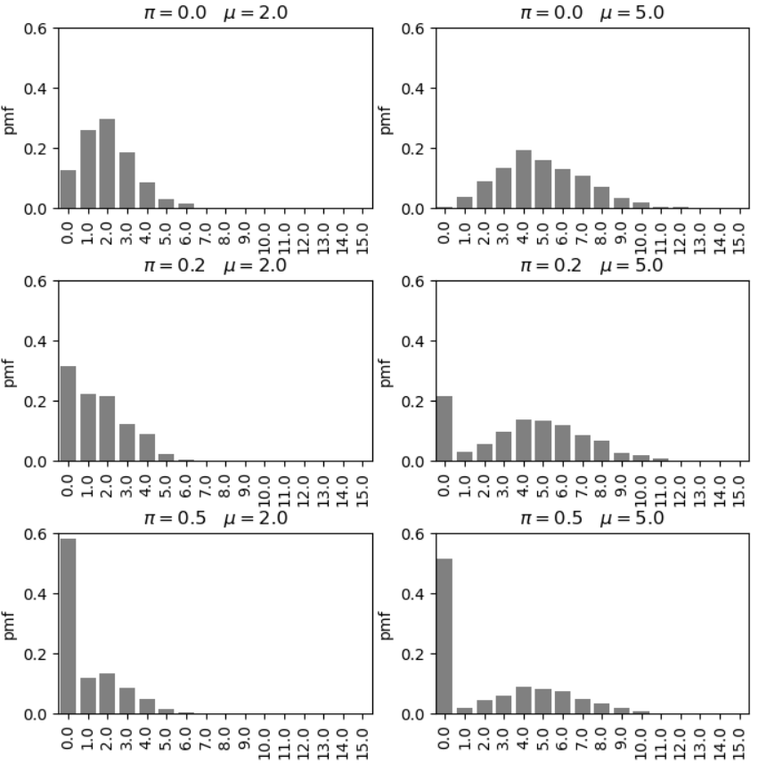
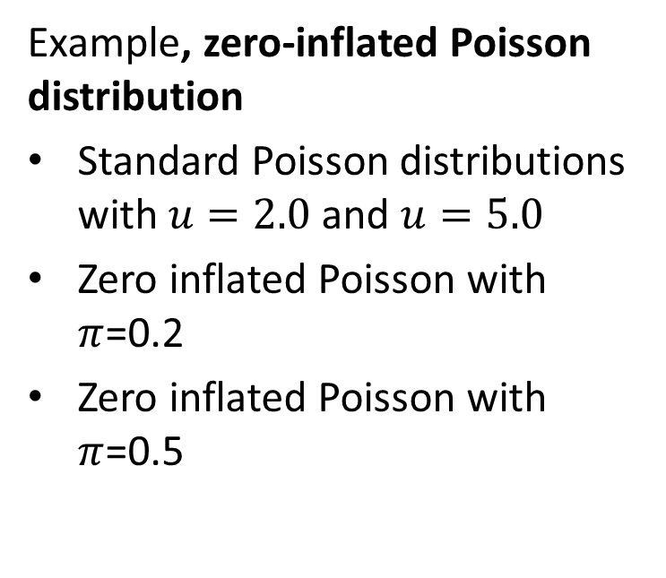
Zero-Inflated Poisson Distribution
Example, zero-inflated Poisson distribution
Standard Poisson distributions with $u=2.0$ and $u=5.0$
Zero inflated Poisson with $π$=0.2
Zero inflated Poisson with $π$=0.5

Slide 11
Models for Over-Dispersed Response

Slide 12
Over-Dispersed Response Distributions
Man
Most people who view an ecommerce site buy 0 products
Most auto drivers have no crashes per year
In much of the world the average rainfall amount on a specific day is 0
The number of sever weather events in a specific area per month is often 0
In epidemiology the probability distribution of the number of people contracting a disease in per day has many zeros
Etc.

Slide 13
Modeling Over-Dispersed Distributions
How can we model over-dispersed distributions?
Two widely used options
Inherently heavy tailed distributions
Mixtures of distributions

Slide 14
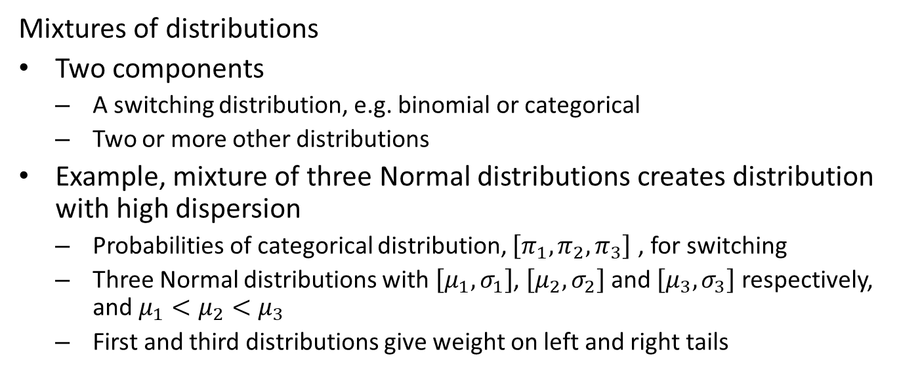
Modeling Over-Dispersed Distributions
Mixtures of distributions
Two components
A switching distribution, e.g. binomial or categorical
Two or more other distributions
Example, mixture of three Normal distributions creates distribution with high dispersion
Probabilities of categorical distribution, $\left[π_{1},π_{2},π_{3}\right]$ , for switching
Three Normal distributions with $\left[μ_{1},σ_{1}\right]$, $\left[μ_{2},σ_{2}\right]$ and $\left[μ_{3},σ_{3}\right]$ respectively, and $μ_{1}<μ_{2}<μ_{3}$
First and third distributions give weight on left and right tails

Slide 15
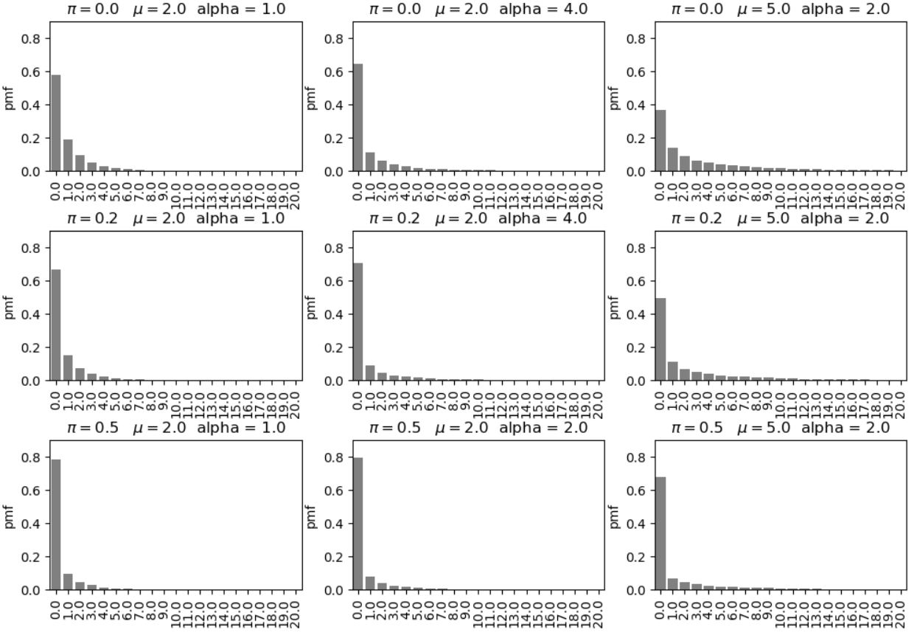
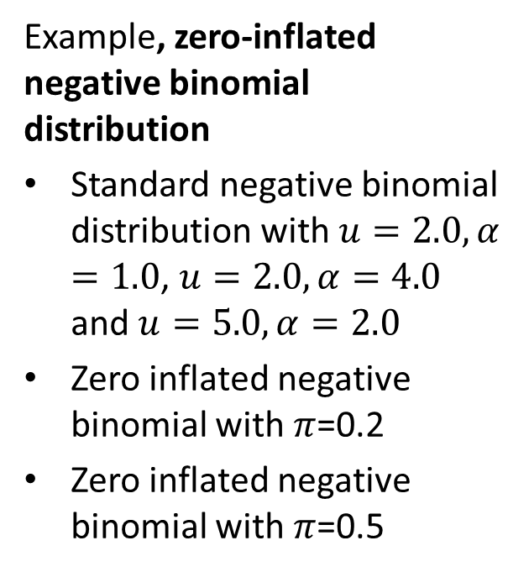
Zero-Inflated Negative Binomial Distribution
Example, zero-inflated negative binomial distribution
Standard negative binomial distribution with $u=2.0, α=1.0$, $u=2.0, α=4.0$ and $u=5.0,α=2.0$
Zero inflated negative binomial with $π$=0.2
Zero inflated negative binomial with $π$=0.5

Slide 16
Dealing with Outliers

Slide 17
Dealing With Outliers
Outliers are a persistent problem with statistical and machine learning models
What are outliers?
Errors or noisy measurements
Result of improper stratification
But, may be of interest
Depending on the application, outliers can be the most interesting values!!
May need to explicitly model
Example: Fraud detection
Example: Scientific discovery
Outliers can be hard to detect
Difficult in high-dimensions
Often find by influence on model

Slide 18
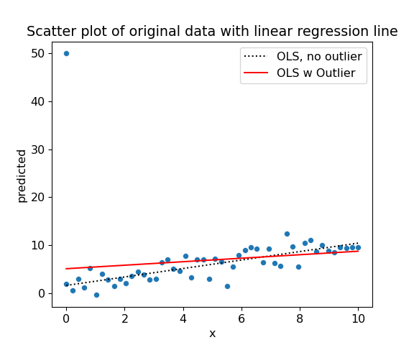
Dealing With Outliers
Example: Add a single outlier regression data set
## Intercept = 5.098 Partial Slope = 0.365

Slide 19
This outlier has high leverage and changes the slope significantly

Slide 20
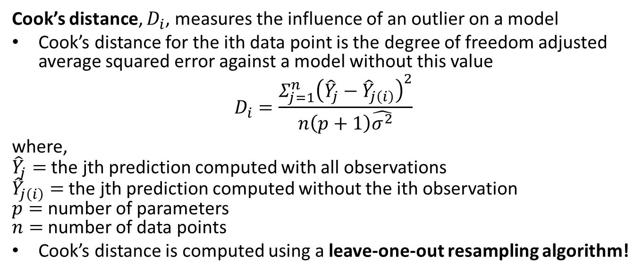
Dealing With Outliers
Cook’s distance, $D_{i}$, measures the influence of an outlier on a model
Cook’s distance for the ith data point is the degree of freedom adjusted average squared error against a model without this value
$$D_{i}=\frac{Σ_{j=1}^{n}{\left({\hat{Y}}_{j}−{\hat{Y}}_{j\left(i\right)}\right)}^{2}}{n\left(p+1\right)\hat{σ^{2}}}$$
where, ${\hat{Y}}_{j}=$ the jth prediction computed with all observations ${\hat{Y}}_{j\left(i\right)}=$ the jth prediction computed without the ith observation $p=$ number of parameters $n=$ number of data points
Cook’s distance is computed using a leave-one-out resampling algorithm!

Slide 21
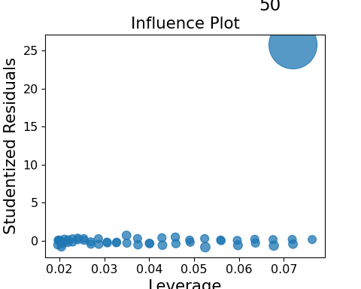
Dealing With Outliers
Plot Cook’s distance as leverage vs. the residual size
_=influence_plot(ols_model_ol)

Slide 22
Outlying points shown at edges of plot
Not all outliers have high leverage
Can detect outliers in moderate dimensions

Slide 23
Dealing With Outliers
Why are linear models sensitive to outliers
Ordinary linear regression uses squared error loss function
Optimal if the errors are iid Normal
Is an unbiased estimator
In 1-dimension median is robust to outliers
But far from an optimal estimator
High bias
Hard to implement beyond 1-dimension
We can study the response of estimators to outliers using an influence function

Slide 24
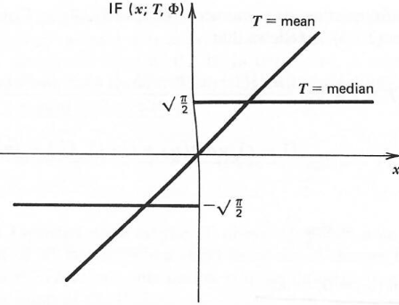
Dealing With Outliers
Compare the influence functions of the mean and median estimators
Mean estimator has linear influence function
Influence of outliers is unbounded
Derivative of the influence function is constant
Influence function of median estimator is discontinuous
Influence of any observation is constant
Derivative of influence function is not defined
Figure from Hampel, el.al., Robust Statistics, 1986
Influence functions for mean and median

Slide 25
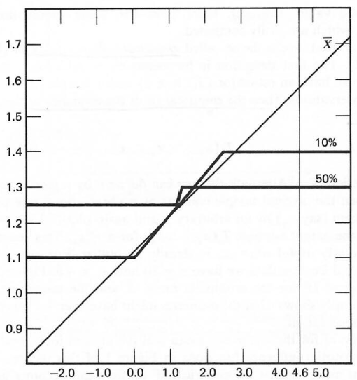

Dealing With Outliers
Could we simply edit out the outliers?
But what fraction of the data are outliers?
Know as the alpha trimmed mean algorithm
Order the values and remove $α/2$ highest and lowest
But, alpha trimming is a bit arbitrary
Is a biased estimator, with bias increasing with $α$
$α=0.5$ is the median
Alpha trimming hard to implement in higher dimensions
Figure from Hampel, el.al., Robust Statistics, 1986
Influence functions for alpha trimmed mean

Slide 26
Dealing With Outliers
Are there better estimators when outliers are present
Yes, but must accept some bias
Idea; estimator can be unbiased near the expected value, but limit influence of outliers
Trade-off between high robustness and low bias
Many ideas have been tried
A major research focus in the 1970s and 1980s
Huber estimator
Family of M-estimators

Slide 27
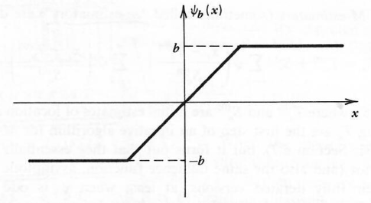

Dealing With Outliers
What are the properties of the Huber estimator?
Influence function is linear near the mean but constant away from the mean
hinge point is at $±t∗MAD$, where $MAD=$ median absolute deviation
Robustness and bias increases as $t$ decreases
Huber estimator is low bias
Unbiased for samples near the point estimate
Constant influence away from the point estimate
Figure from Hampel, el.al., Robust Statistics, 1986
Influence function of the Huber estimator

Slide 28
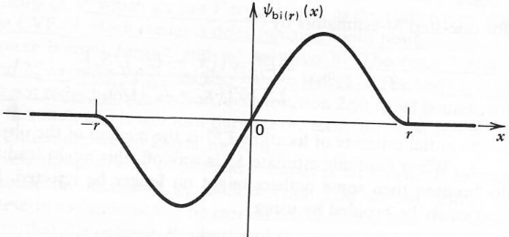

Dealing With Outliers
M-estimators tapper influence to zero
Approximately linear influence near point estimate
So nearly unbiased near the point estimate
Influence tappers to 0 for extreme outliers
An example is Tukey’s biweight
Only a single parameter for biweight function, $r$
Robustness and bias increase with decreasing $r$
Figure from Hampel, el.al., Robust Statistics, 1986
Influence function of the Tukey’s Biweight M-estimator

Slide 29

Dealing With Outliers
Example: regression with Huber loss function
## Define the robust regression model and fit it to the data ols_model_huber = smf.rlm(formula ='y~x', data = sim_data_ol).fit() # Add predicted to pandas data frame sim_data_ol['predicted_huber'] = ols_model_huber.predict(sim_data_ol.x) ## Display sumamry ols_model_huber.summary()

Slide 30
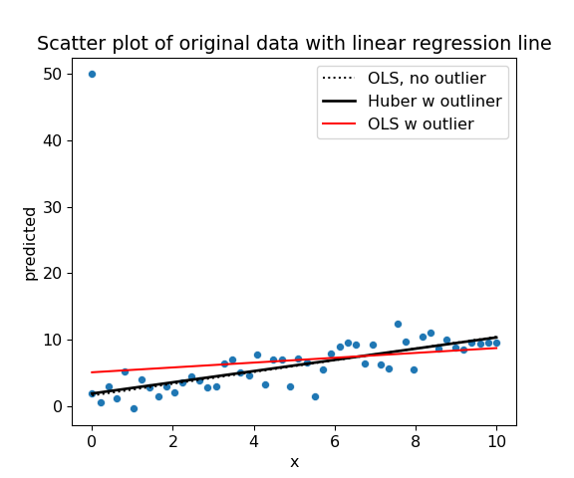
Dealing With Outliers
Example: regression with Huber loss function

Slide 31
Notice the different slope for the regression with Huber loss

Slide 32
Summary
Linear models are a flexible and widely used class of models
Fit model coefficients by least squares estimation
Can use many types of predictor variables
SGD and L-FBGS algorithms allow massive scaling of linear models
We prefer the simplest model that does a reasonable job
The principle of Occam’s razor
Must consider the bias-variance trade-off
Use robust methods if outliers are present

Slide 33
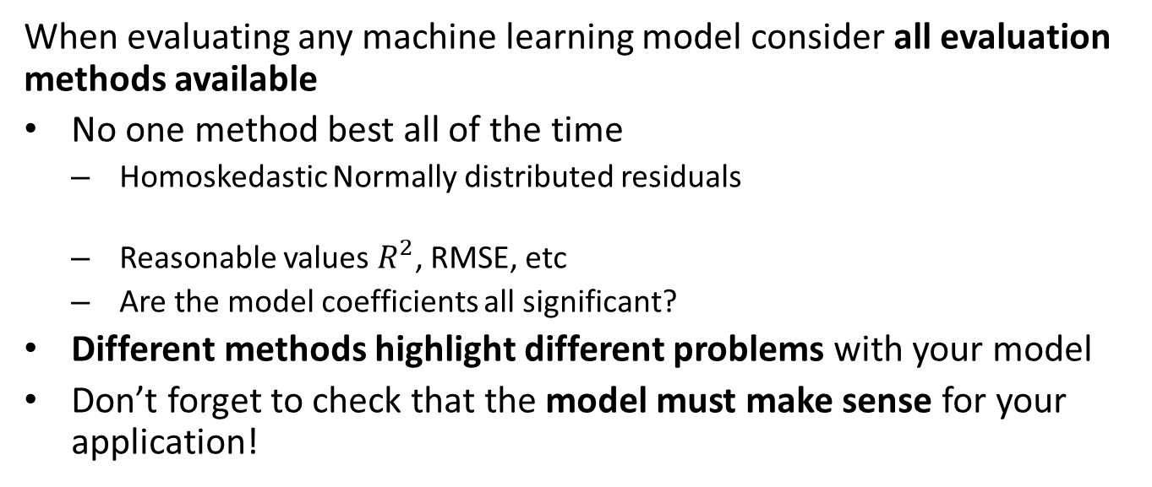
Summary
When evaluating any machine learning model consider all evaluation methods available
No one method best all of the time
Homoskedastic Normally distributed residuals
Reasonable values $R^{2}$, RMSE, etc
Are the model coefficients all significant?
Different methods highlight different problems with your model
Don’t forget to check that the model must make sense for your application!

